Slide 1
The Wine Predictor Gadget
Group 6
Project 4
Susan
Ali
Joe
Adam

Slide 2
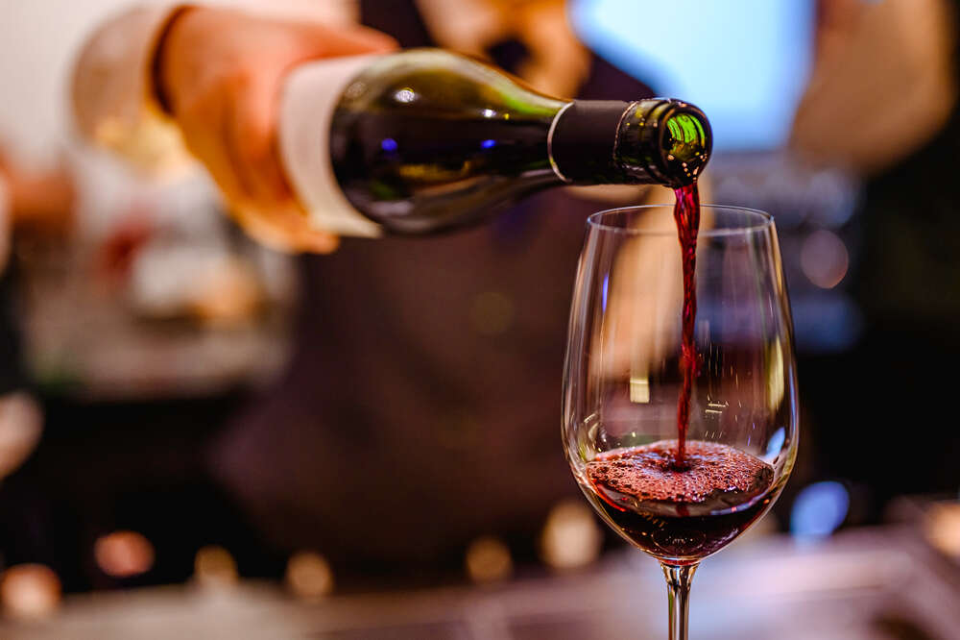
Goal
Use machine learning to create an unsupervised model that can recommend new wines that have similar attributes to a user’s selections.

Slide 3
Process
Pandas
Import Data (6400+ datapoints)
Transform/Clean - Drop unnecessary columns
Machine Learning
Unsupervised Machine Learning: K-Means Clustering
SQLite
Loaded dataframe from pandas into SQLite
Flask
Deploy API from SQLite
Javascript
Fetch Data for predictions using D3 from Flask
HTML/CSS
Display Predictions from Javascript
End Result
WINE TIME

Slide 4
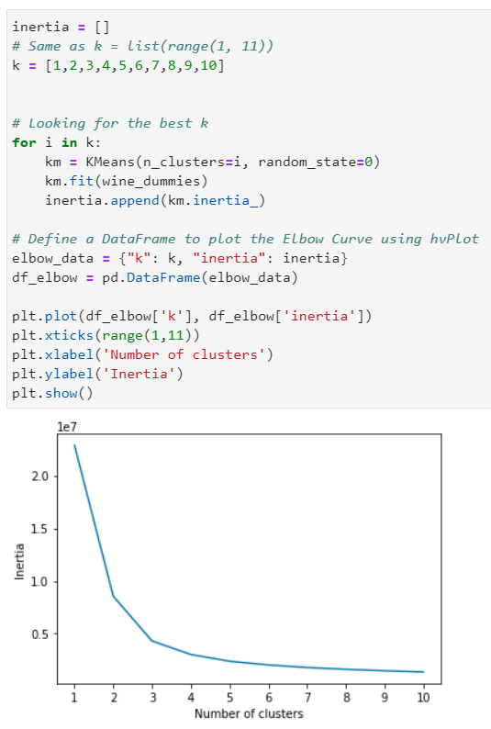
Machine Learning
Used Unsupervised Machine Learning
K-Means Clustering
The model creates five clusters (or inertia, k = 5)

Slide 5
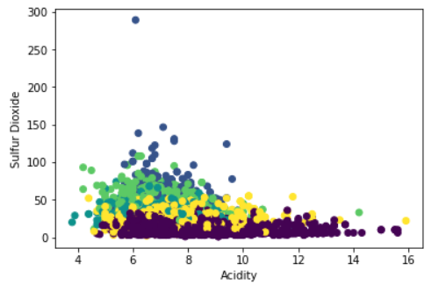
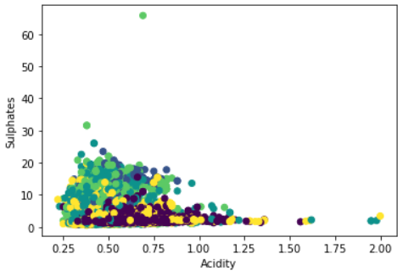
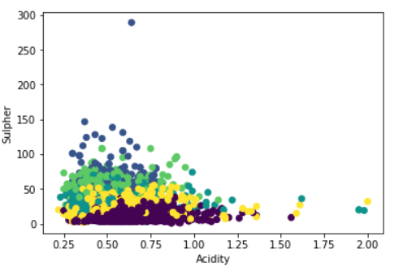
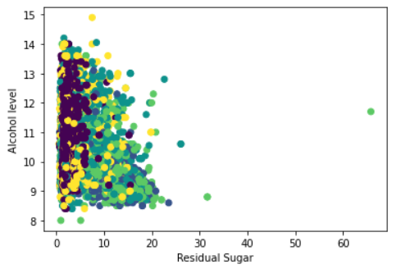
K-Means Clustering

Slide 6
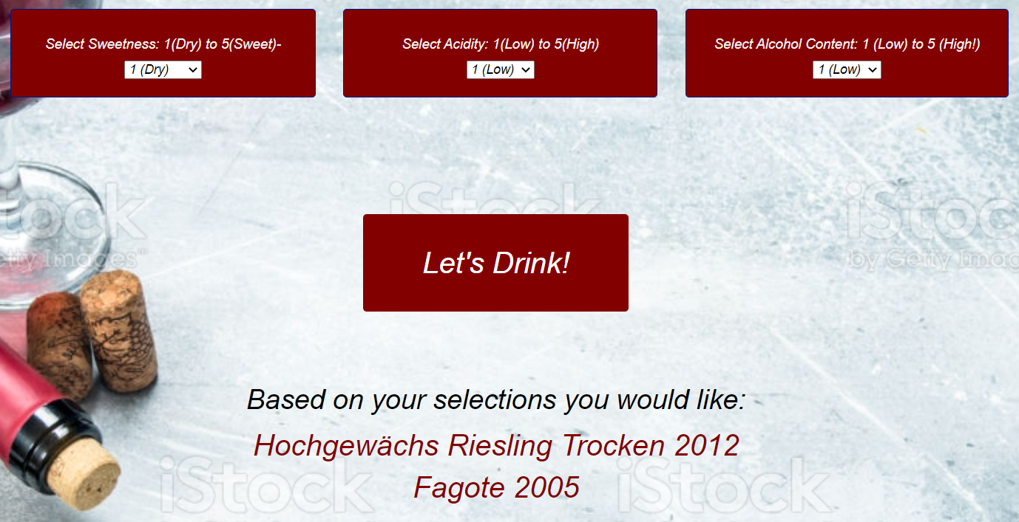
Result

Slide 7
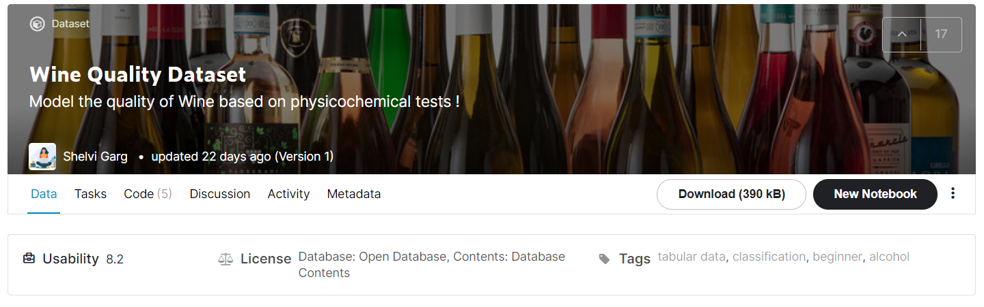
Source
https://www.kaggle.com/shelvigarg/wine-quality-dataset

